Slide 1
Road Traffic Accidents (RTA)
GA DAT3 Data Science Project
May 27th 2017 : Final Report

Slide 2
Presentation coverage
Scope of project
Approach
Data sources
Data Analysis
Machine Learning
Data processing
Data flows
Data assessment review
Roads (Motorway)
Machine Learning (Accident severity)
Feature selection
Dataset preparation
Classifiers
Assessment
Improvements
Approx 30 mins

Slide 3
Original Project scope
Aim
Determine if there are any key influencers on UK road accidents based on identifiable features from government provided, public data.
Provide data assessment and reporting to highlight observations
Determine if there any features that can be used to predict levels of accidents at a road specific level
Focus
Motorway accident statistics and features

Slide 4
Changed Project scope
Aim
Determine if there are any key influencers on UK road accidents based on identifiable features from government provided, public data.
Provide data assessment and reporting to highlight observations
Determine if there any features that can be used to predict levels of accidents across UK
Focus
Accident Severity statistics and features
Can the severity level of an accident be ‘machine learnt’ with this data?

Slide 5
Approach

Slide 6
Data Sources
Gov.uk data
Accidents (140k records)
Vehicles (258k records)
Casualties (186k records)
Speedcams.eu data
UK Speed Cameras (4k records)
Map data
UK postcode shape file (2MB)
London roads GEOJSON file (386 MB)
Accidents
Casualties
Vehicles
Speed cameras
Map Data
(lat, lon)
(lat, lon)
Data Specifications

Slide 7
Data source information
Datasets provided by the UK government on road safety will be used. This includes those with raw data, collections or statistical tables.
The following datasets were pre-processed into a dataFrame (or two) for analysis and reporting purposes:
https://data.gov.uk/dataset/road-accidents-safety-data
Postcodes, Traffic cameras
M25 JSON file
https://www.gov.uk/government/collections/driving-test-operational-statistics https://www.gov.uk/government/collections/road-accidents-and-safety-statistics https://www.gov.uk/government/statistical-data-sets/road-accidents-and-safety-statistical-tables-index https://www.gov.uk/government/policies/road-safety

Slide 8
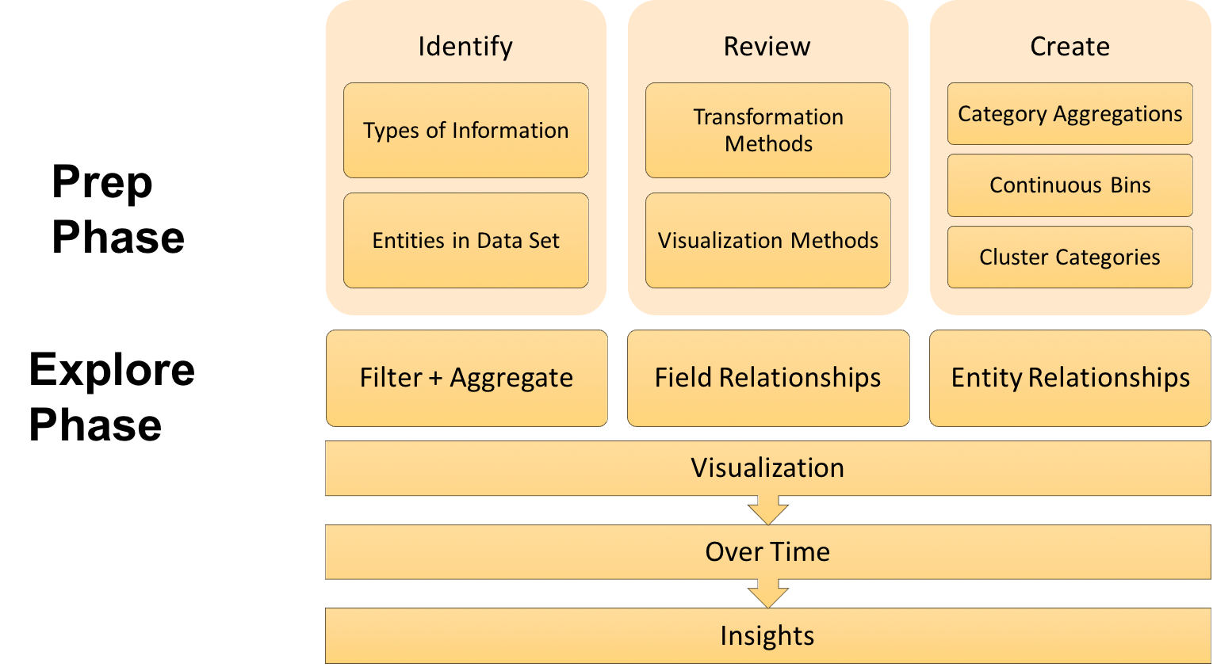
Data Analysis
From ‘Data Exploration with Python’ a District Datalabs blog by Tony Ojeda. Article published by Elixir.

Slide 9
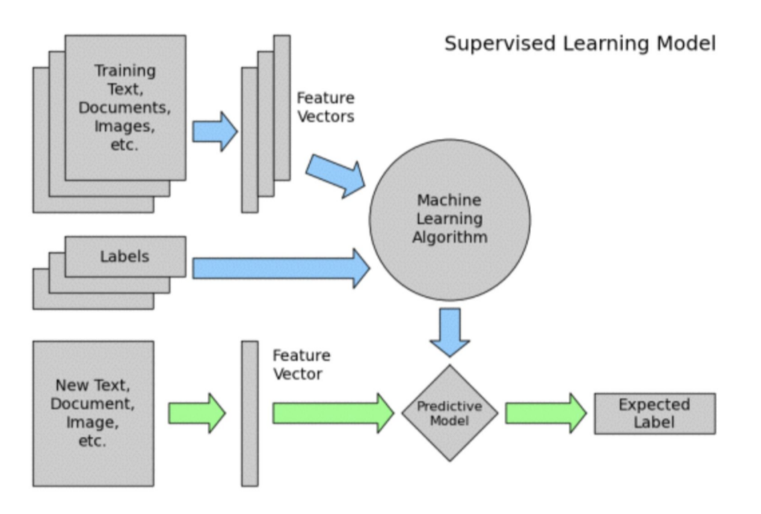
Machine Learning

Slide 10
Data processing – ‘hacking’
Python – using Jupyter for ‘documentation’
Spyder IDE for debugging (although not really used for this project!)
Pandas DataFrames for datasets
Use of ‘pickle’ files
Capture data for faster replay
Multiple ‘downstream’ usage
Filtering data
Leave to as late as possible to avoid loss of ‘useful’ data
Filter when scope fixing or performance efficiency needed.
Functionality
Source data capture and cleaning
Data review and analysis
Feature and label dataset preparation
Machine learning test/training
Reporting

Slide 11
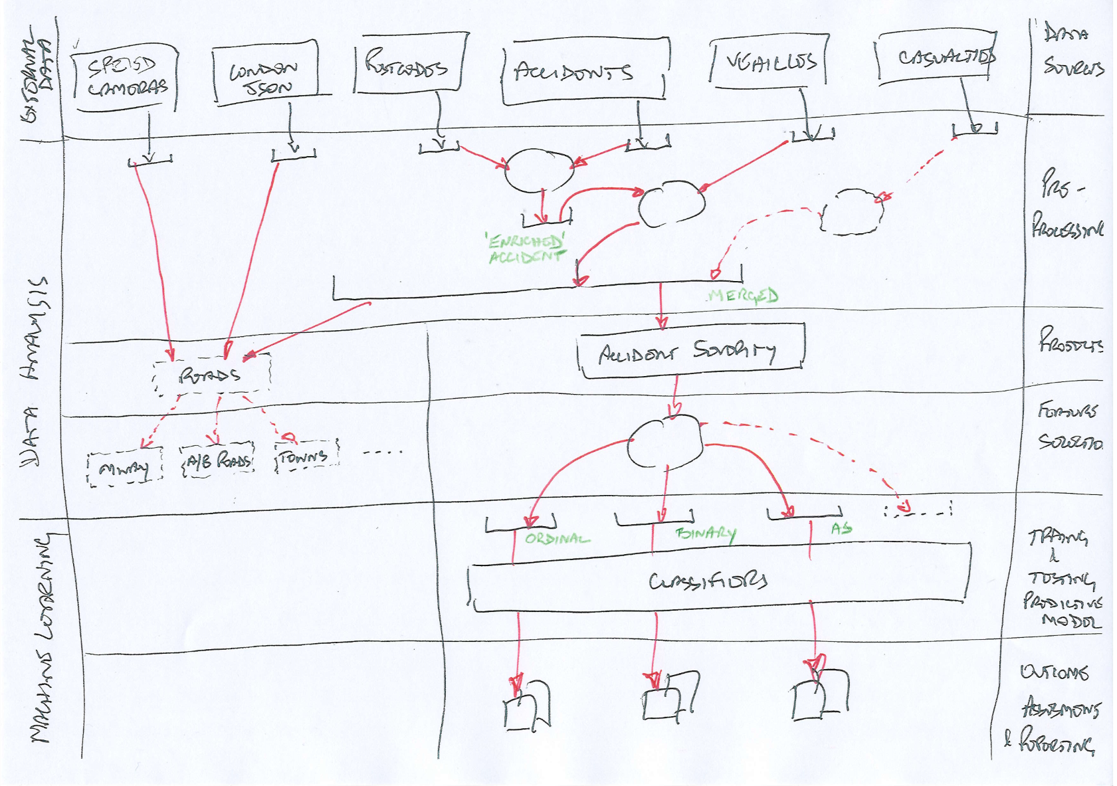
Data processing - dataflow

Slide 12
Data Assessment review

Slide 13
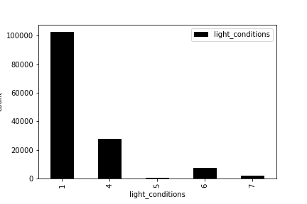
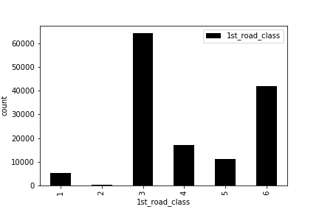
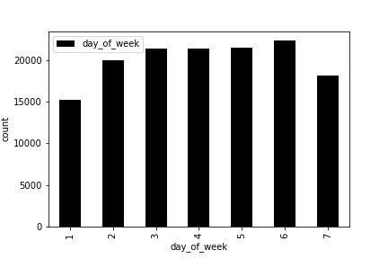
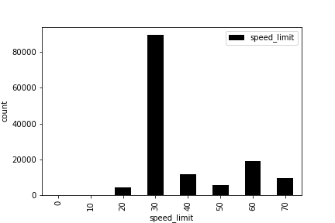
Accident Data - Assessment
1 - Daylight 4 - Darkness - lights lit 5 - Darkness - lights unlit 6 - Darkness - no lighting 7 - Darkness - lighting unknown
1-Motorway 2-A(M) 3-A 4-B 5-C 6-Unclassified
1-Sunday 2-Monday 3-Tuesday
4-Wednesday
5-Thursday
6-Friday
7-Saturday

Slide 14
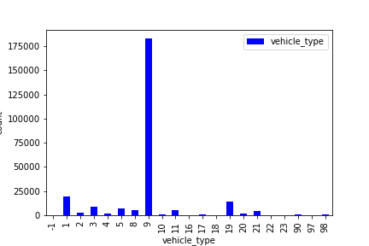
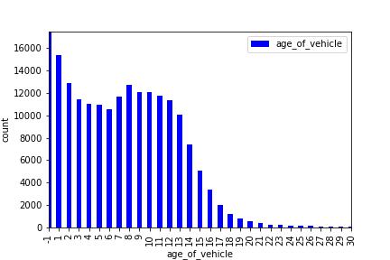
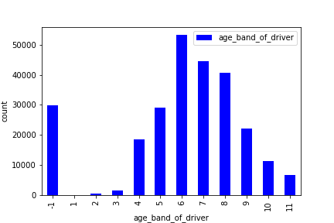
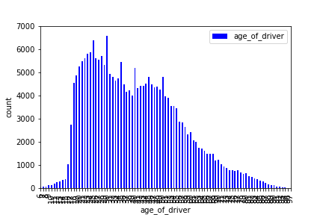
Vehicle Data - assessment
1 - Pedal cycle
2 - Motorcycle 50cc and under
3 - Motorcycle 125cc and under
4 - Motorcycle over 125cc and up to 500cc
5 - Motorcycle over 500cc
8 - Taxi/Private hire car
9 - Car
10 - Minibus (8 - 16 passenger seats)
11 - Bus or coach (17 or more pass seats)
16 - Ridden horse
17 - Agricultural vehicle
18 - Tram
19 - Van / Goods 3.5 tonnes mgw or under
20 - Goods over 3.5t. and under 7.5t
21 - Goods 7.5 tonnes mgw and over
22 - Mobility scooter
23 - Electric motorcycle
90 - Other vehicle
97 - Motorcycle - unknown cc
98 - Goods vehicle - unknown weight
-1 - NaN
25
45
-1 – NaN
1 - 0 – 5
2 - 6 – 10
3 - 11 – 15
4 - 16 – 20
5 - 21 – 25
6 - 26 – 35
7 - 36 – 45
8 - 46 – 55
9 - 56 – 65
10 - 66 – 75
11 - Over 75

Slide 15
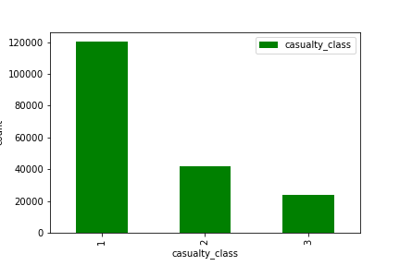
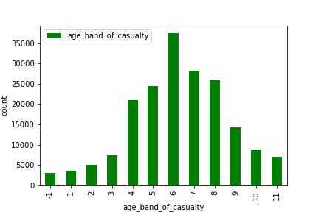
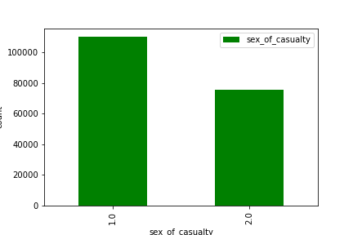
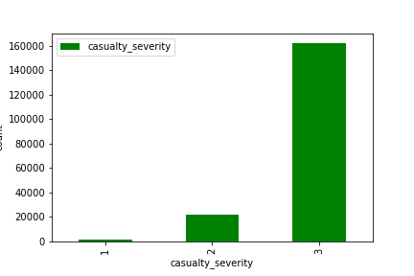
Casualty Data - Assessment
1 - Driver or rider
2 - Passenger
3 - Pedestrian
-1 – NaN
1 - 0 – 5
2 - 6 – 10
3 - 11 – 15
4 - 16 – 20
5 - 21 – 25
6 - 26 – 35
7 - 36 – 45
8 - 46 – 55
9 - 56 – 65
10 - 66 – 75
11 - Over 75
1 - Male 2 - Female 3 - Not known
1 - Fatal 2 - Serious 3 - Slight

Slide 16
Postcode enrichment
The UK postal system uses postcodes to help with automating the sorting and delivery of mail. This is made up of a 2-part code, an out code and an in code. As the out code is the most significant part of the system, it can be used to obtain a rough area level break up of the UK. There are approximately 2971 out codes and approximately 1.74M full postcodes (out code + in code)†.
The UK shapefile uses only the first 2 characters of the outcode.
Reverse geolocation is available through varios APIs (e.g. Google) but are cost limited based on daily volume of requests.
A two step process is undertaken to identify an out-code for each Accident lat/lon pair.
This process may not be fully accurate, but suffices for the map data population purposes
†from https://www.freemaptools.com

Slide 17
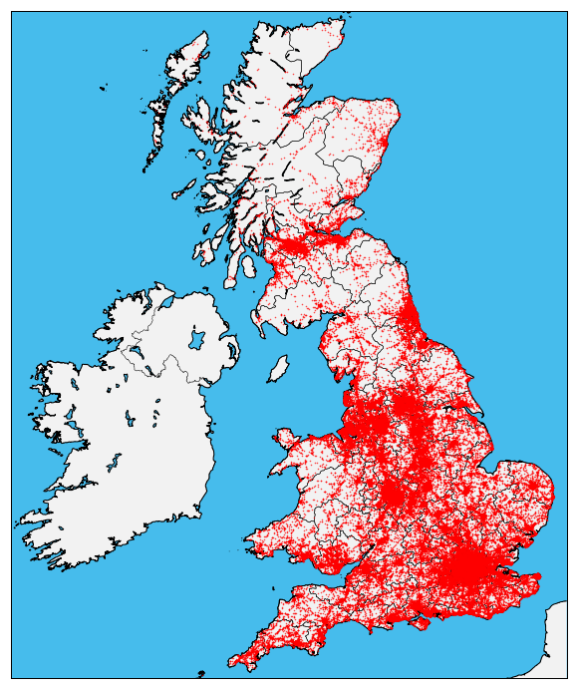
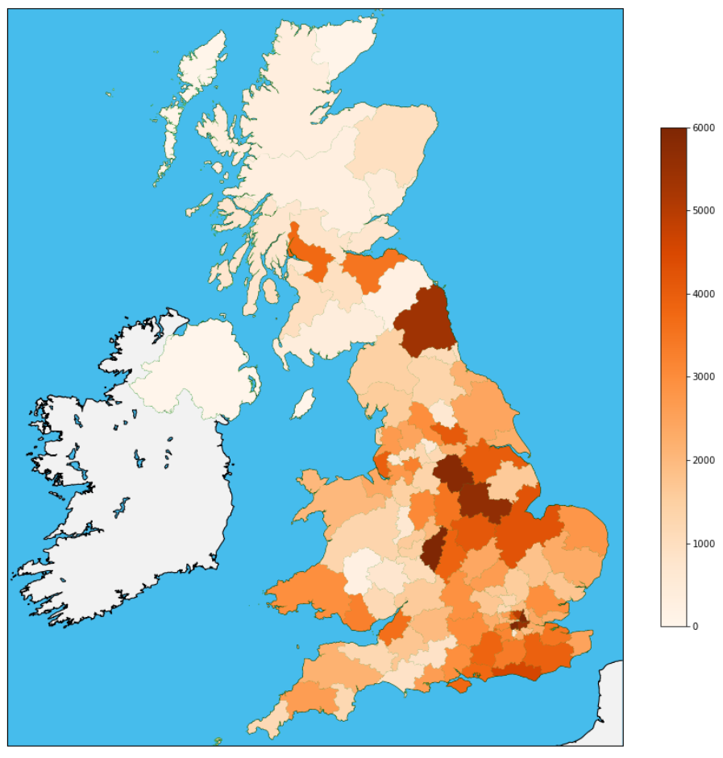
Data review – maps
All accidents 2015 (item level)
All accidents 2015 (postcode)

Slide 18
Roads
Motorways

Slide 19
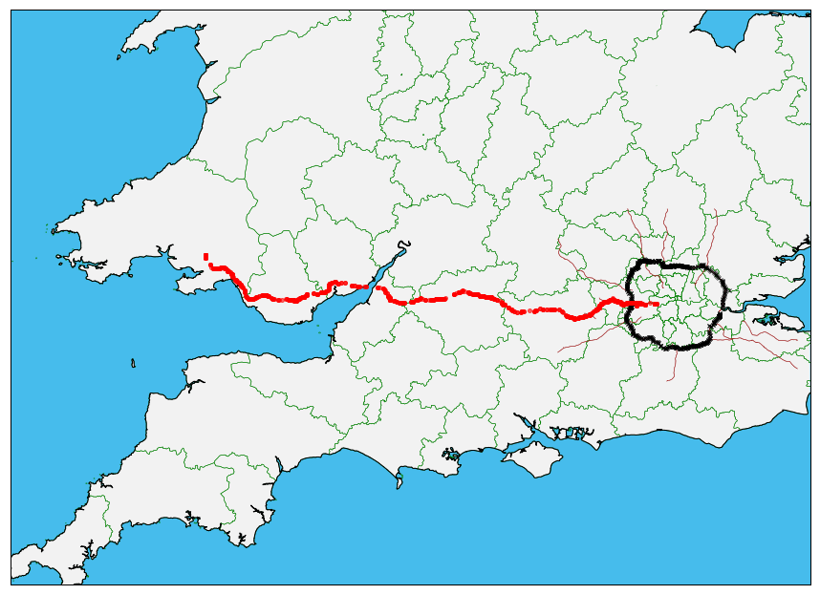
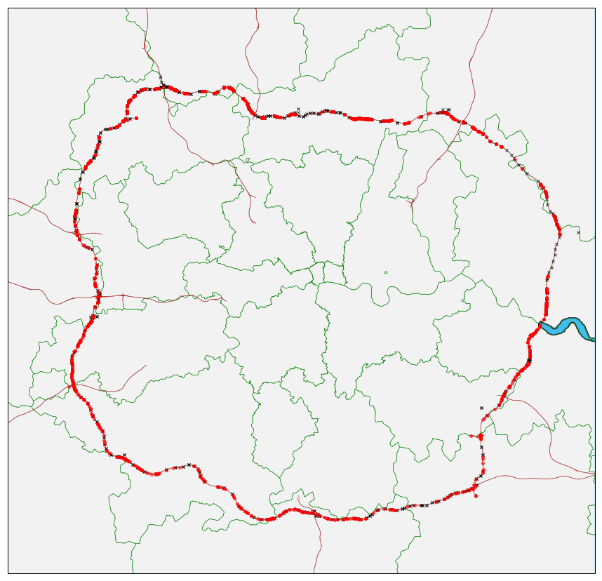
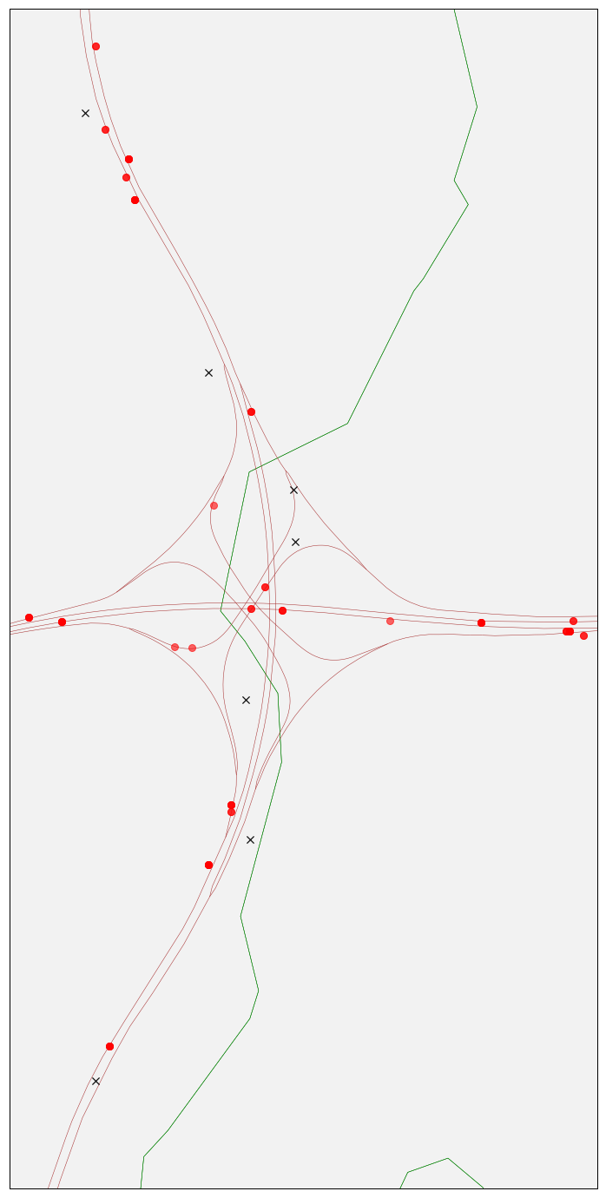
Road selection and visualisation
M4 accidents 2015
M25 accidents 2015
M4/25 junction
accidents 2015

Slide 20
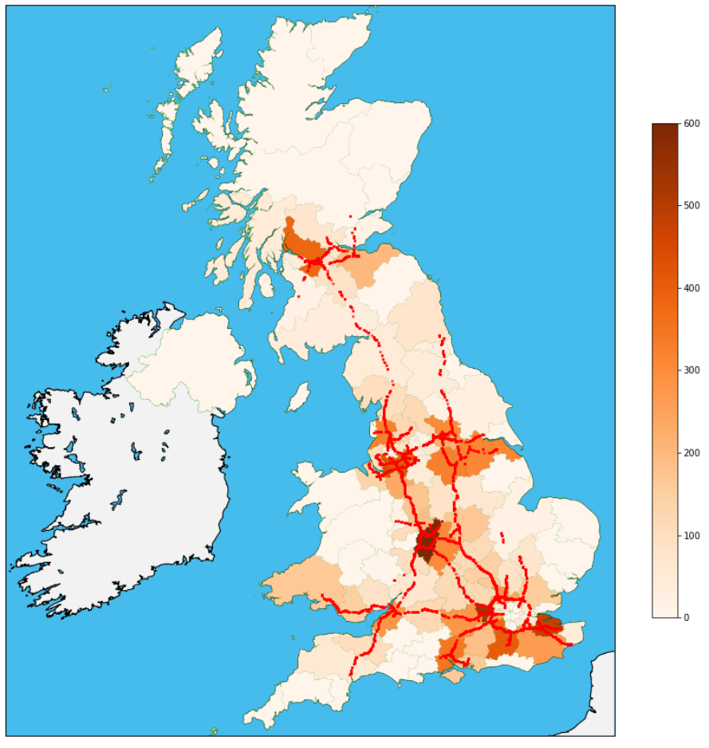
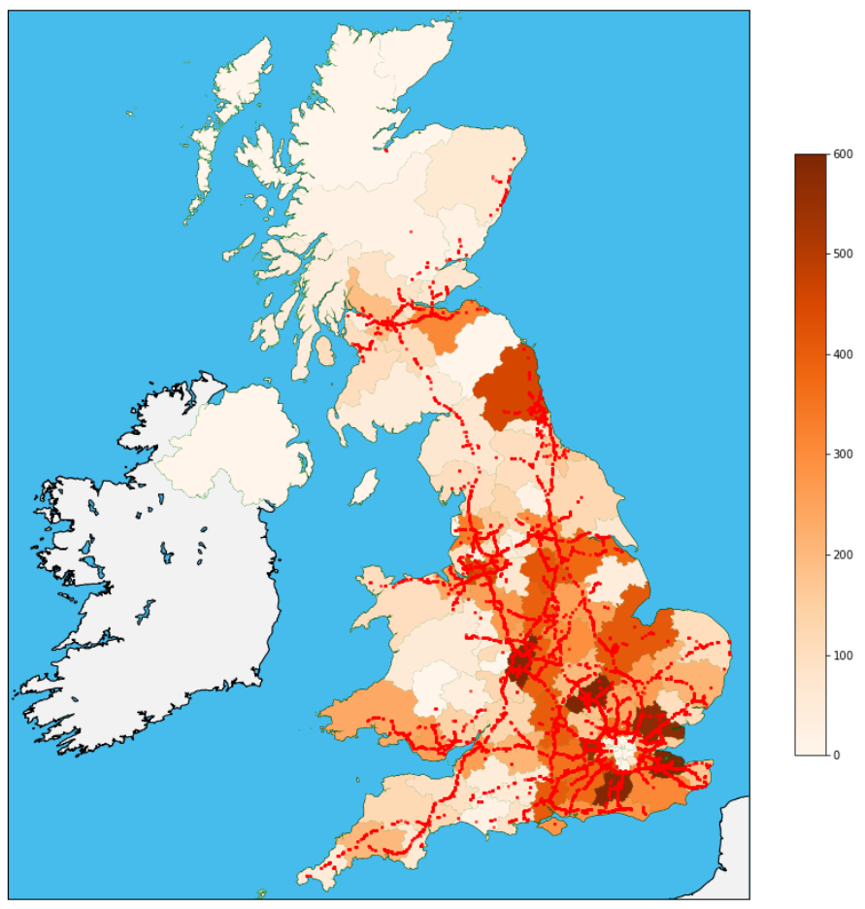
Data review – Fast roads
All Motorway accidents 2015
All (70 mph road) accidents 2015

Slide 21
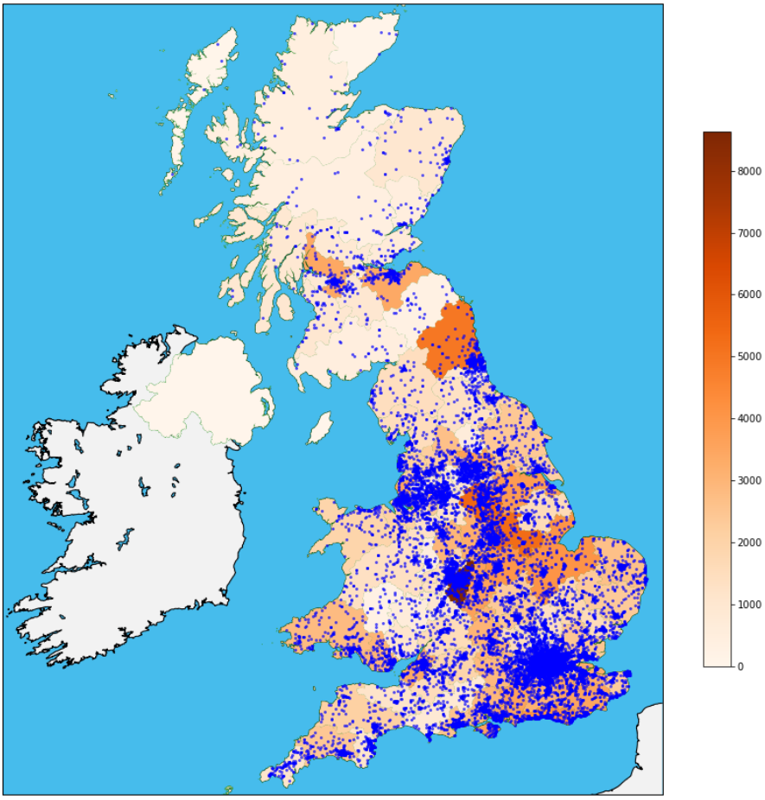
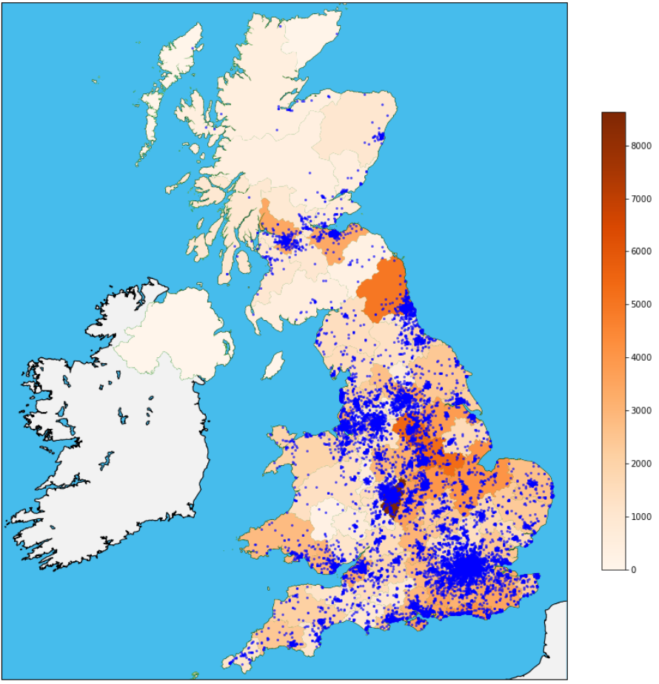
Data review – town clustering
All motorbike accidents 2015
All pushbike accidents 2015

Slide 22
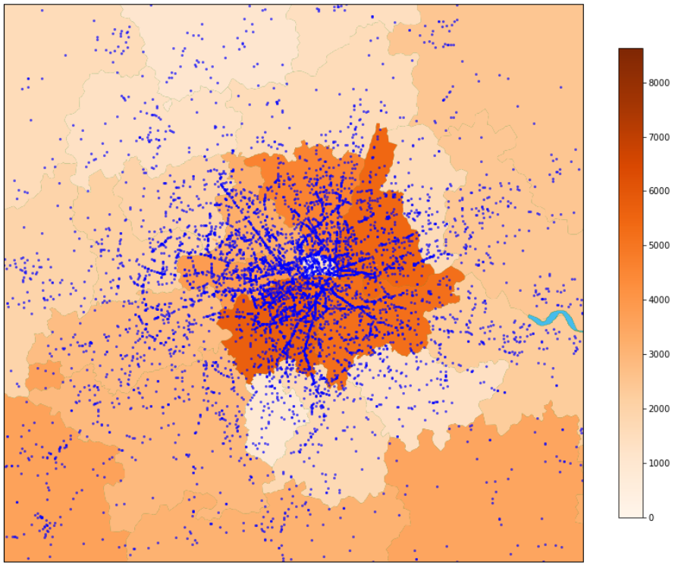
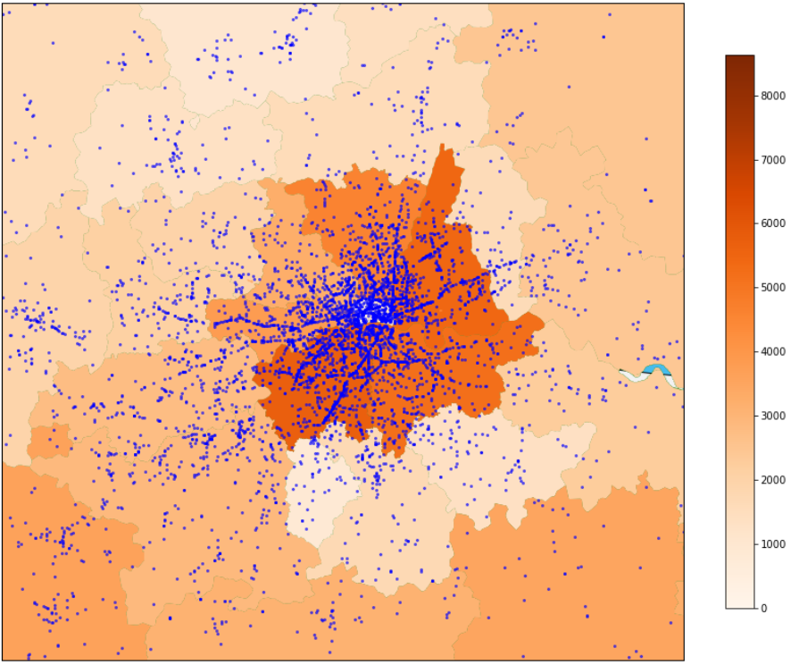
Data review – town clustering London within M25 ring road
All motorbike accidents 2015
All pushbike accidents 2015

Slide 23
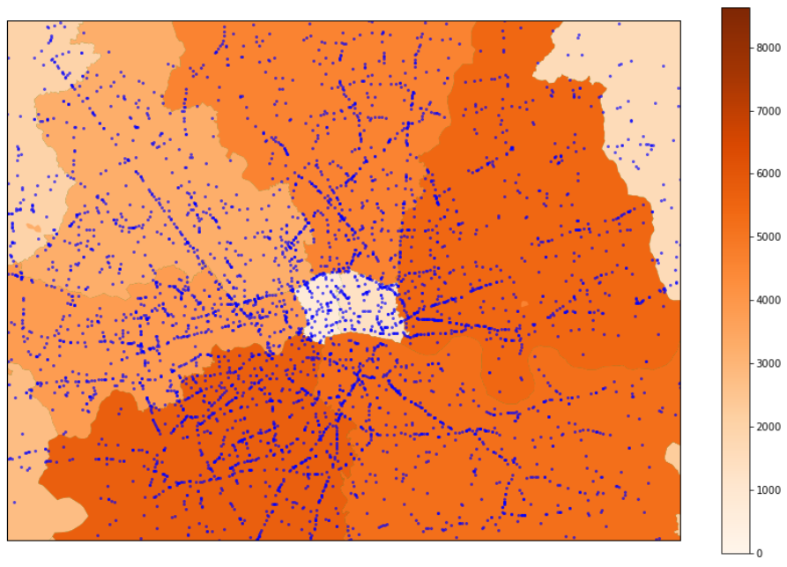
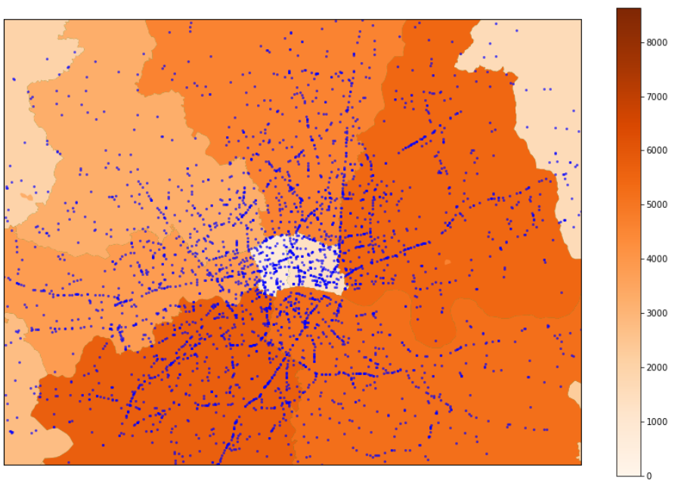
Data review – town clustering London within North/South Circular ring road
All motorbike accidents 2015
All pushbike accidents 2015

Slide 24
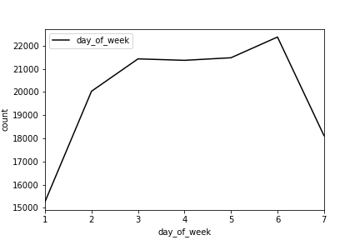
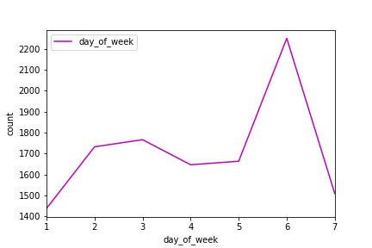
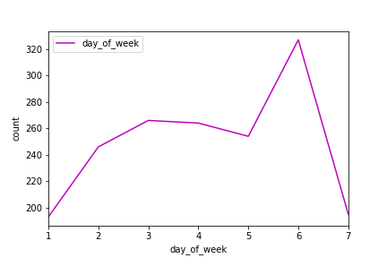
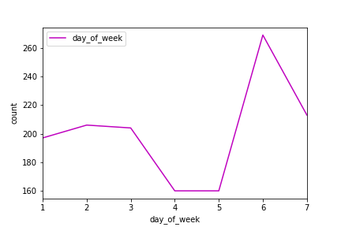
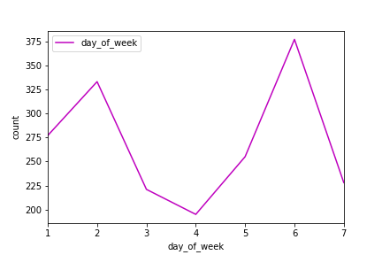
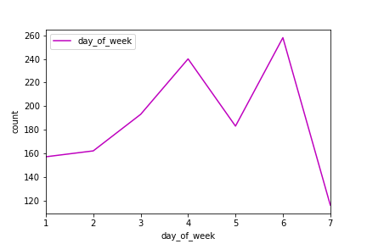
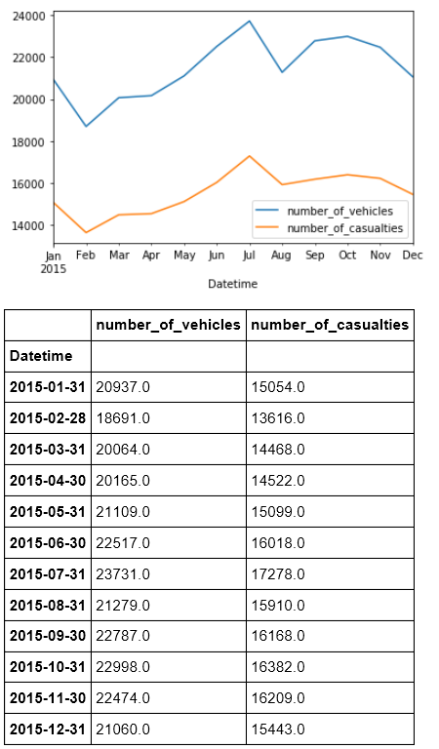
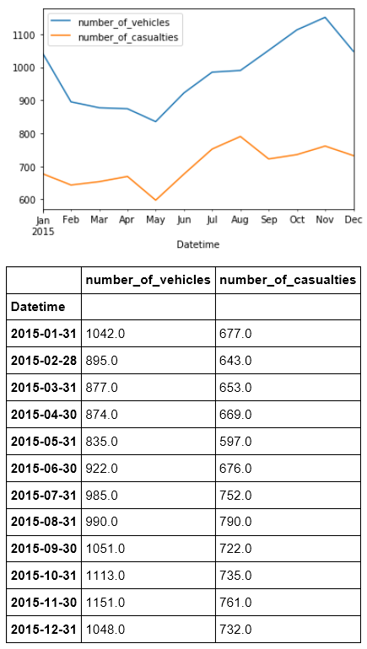
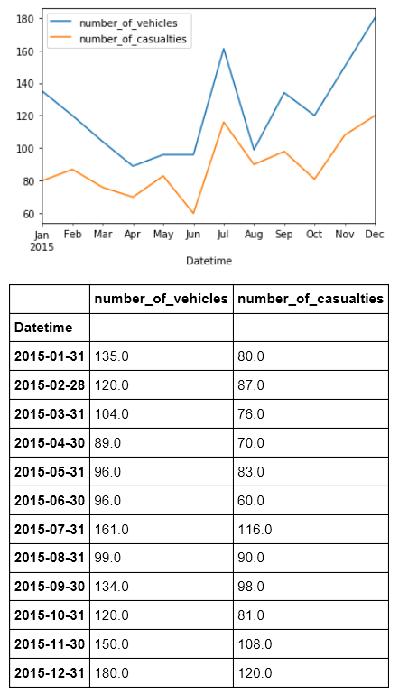
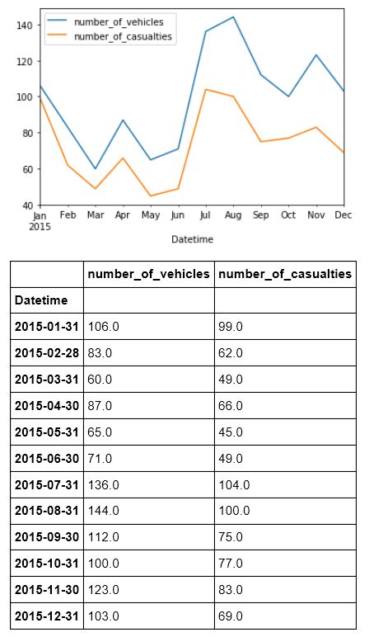
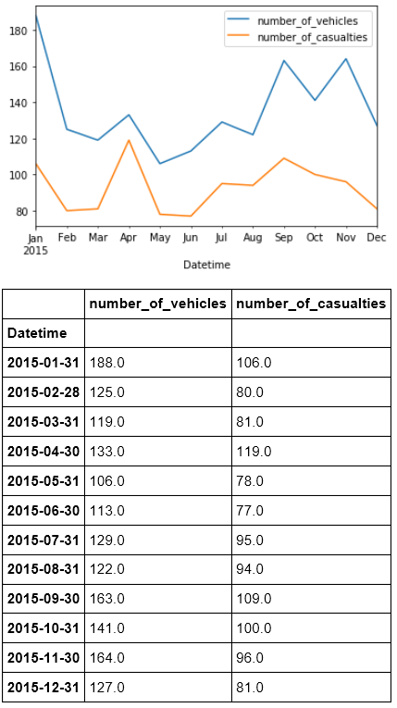
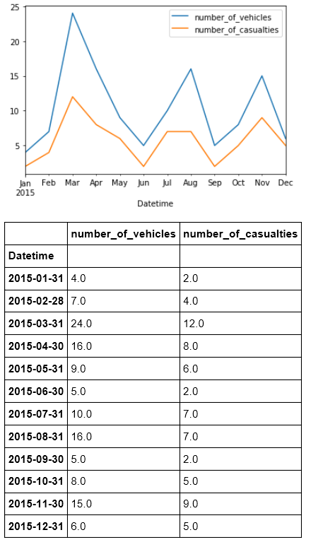
Motorway assessment (2015)
Project focus on Motorways
Seasonal view of accidents shown below
Daily
All Accidents
All Motorways
M1
M4
M6
M25
Yearly

Slide 25
Machine Learning
Accident Severity

Slide 26
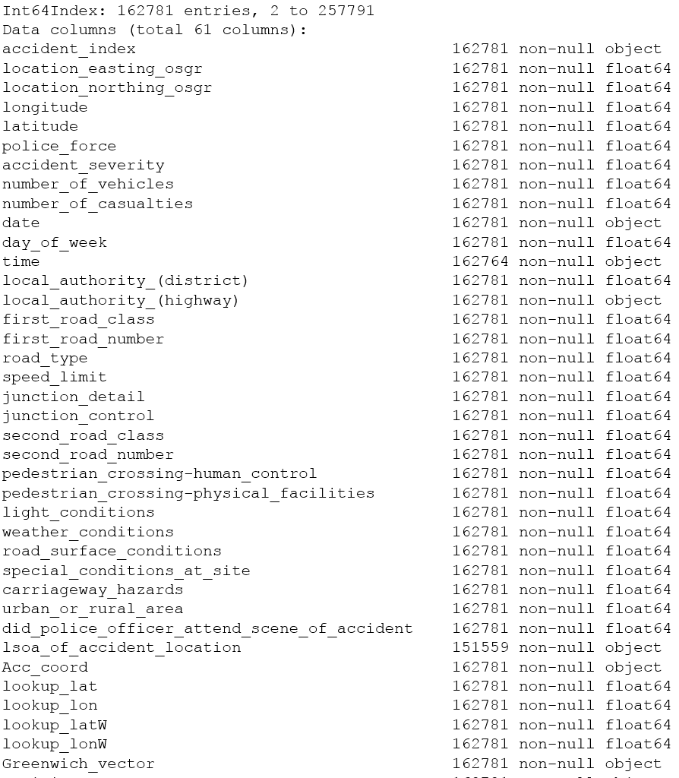
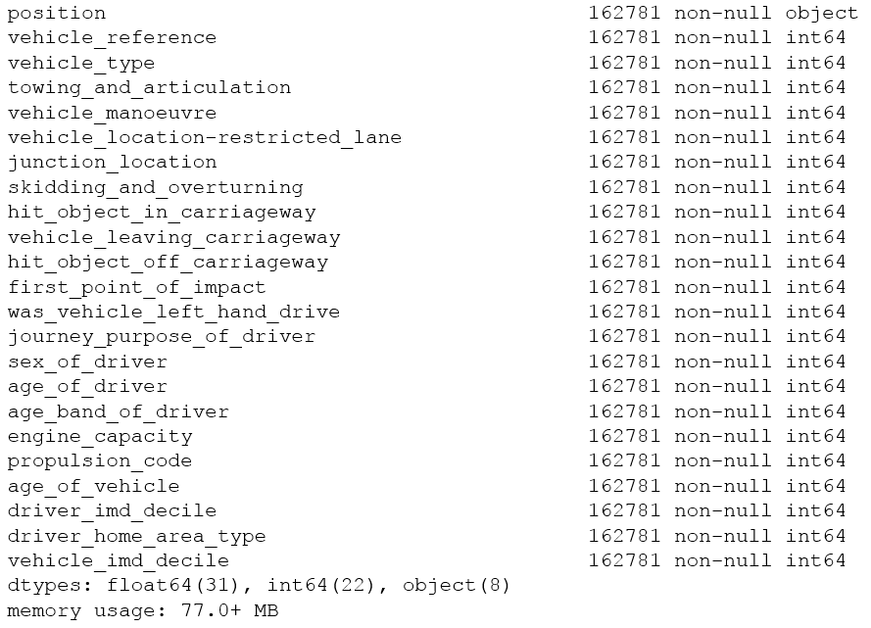
Merged Data

Slide 27
Accidents – Feature choice
Data description | Range of codes/ Entity code | Example_Data | Comments | Field classifier
Date | (DD/MM/YYYY) | 12/1/2015 | Feature - combine with time field and make index | Feature
Time | (HH:MM) | 18:45 | Feature - combine with Date field and make index | Feature
1st Road Class | 1-Motorway 2-A(M) 3-A 4-B 5-C 6-Unclassified | 5 | ID of road type. Can map to road ID : e.g. 1 ≡ 'M' in 'M25' | Feature
1st Road Number |  | 0 | ID of road. Can map to road ID : e.g. 123 ≡ '123' in 'A123' | Feature
Speed limit |  | 30 |  | Feature
Junction Detail | 0 - Not at junction or within 20 metres 1- Roundabout 2 - Mini-roundabout 3 - T or staggered junction 5 - Slip road 6 - Crossroads 7 - More than 4 arms (not roundabout) 8 - Private drive or entrance 9 - Other junction -1 - Data missing or out of range | 3 | Not clear how this is populated for Motorways (TBD) | Feature
Light Conditions | 1 - Daylight 4 - Darkness - lights lit 5 - Darkness - lights unlit 6 - Darkness - no lighting 7 - Darkness - lighting unknown - 1 - NaN | 4 |  | Feature
Weather Conditions | 1 - Fine no high winds 2 - Raining no high winds 3 - Snowing no high winds 4 - Fine + high winds 5 - Raining + high winds 6 - Snowing + high winds 7 - Fog or mist 8 - Other 9 - Unknown -1 - NaN | 1 |  | Feature
Road Surface Conditions | 1 - Dry 2 - Wet or damp 3 - Snow 4 - Frost or ice 5 - Flood over 3 cm. deep 6 - Oil or diesel 7 - Mud -1 - NaN | 1 |  | Feature
Day of Week | 1-Sunday … 7-Saturday | 2 |  | Feature

Slide 28
Vehicle features
Data description | Range of codes/ Entity code | Example_Data | Comments | Field classifier
Vehicle Type | 1 - Pedal cycle 2 - Motorcycle 50cc and under 3 - Motorcycle 125cc and under 4 - Motorcycle over 125cc and up to 500cc 5 - Motorcycle over 500cc 8 - Taxi/Private hire car 9 - Car 10 - Minibus (8 - 16 passenger seats) 11 - Bus or coach (17 or more pass seats) 16 - Ridden horse 17 - Agricultural vehicle 18 - Tram 19 - Van / Goods 3.5 tonnes mgw or under 20 - Goods over 3.5t. and under 7.5t 21 - Goods 7.5 tonnes mgw and over 22 - Mobility scooter 23 - Electric motorcycle 90 - Other vehicle 97 - Motorcycle - unknown cc 98 - Goods vehicle - unknown weight -1 – NaN | 19 |  | Feature
Vehicle Manoeuvre | 1 - Reversing 2 - Parked 3 - Waiting to go - held up 4 - Slowing or stopping 5 - Moving off 6 - U-turn 7 - Turning left 8 - Waiting to turn left 9 - Turning right 10 - Waiting to turn right 11 - Changing lane to left 12 - Changing lane to right 13 - Overtaking moving vehicle - offside 14 - Overtaking static vehicle - offside 15 - Overtaking - nearside 16 - Going ahead left-hand bend 17 - Going ahead right-hand bend 18 - Going ahead other -1 - NaN | 9 |  | Feature
Sex of Driver | 1 - Male 2 - Female 3 - Not known -1 - NaN | 1 |  | Feature
Age of Driver |  | -1 |  | Feature
Age Band of Driver | 1 - 0 - 5 2 - 6 - 10 3 - 11 - 15 4 - 16 - 20 5 - 21 - 25 6 - 26 - 35 7 - 36 - 45 8 - 46 - 55 9 - 56 - 65 10 - 66 - 75 11 - Over 75 -1 - NaN | -1 |  | Feature
Engine Capacity |  | 2143 |  | Feature
Age of Vehicle | (manufacture) | 4 |  | Feature

Slide 29
Dataset creation
Confirm features (X) from chosen merged data source
Identify target (y) – Accident severity (ternary category)
Fields are already numeric so no need to use Pandas’ “get_dummies”
Generate proposed feature column datasets
Ordinal: use fields as is with multiple discrete values (e.g. road-types) Source data discovery
Binary: extract each chosen field type into separate binary feature. (e.g. A, B, roads)
Accident Severity: minimum dataset
Control: leave (y) in as a feature to determine if classifier can pick up perfect match.
Create correlation heatmaps
Reassess feature choice
Reduce correlation
Filter residual unpopulated items
Regenerate and optimise datasets

Slide 30
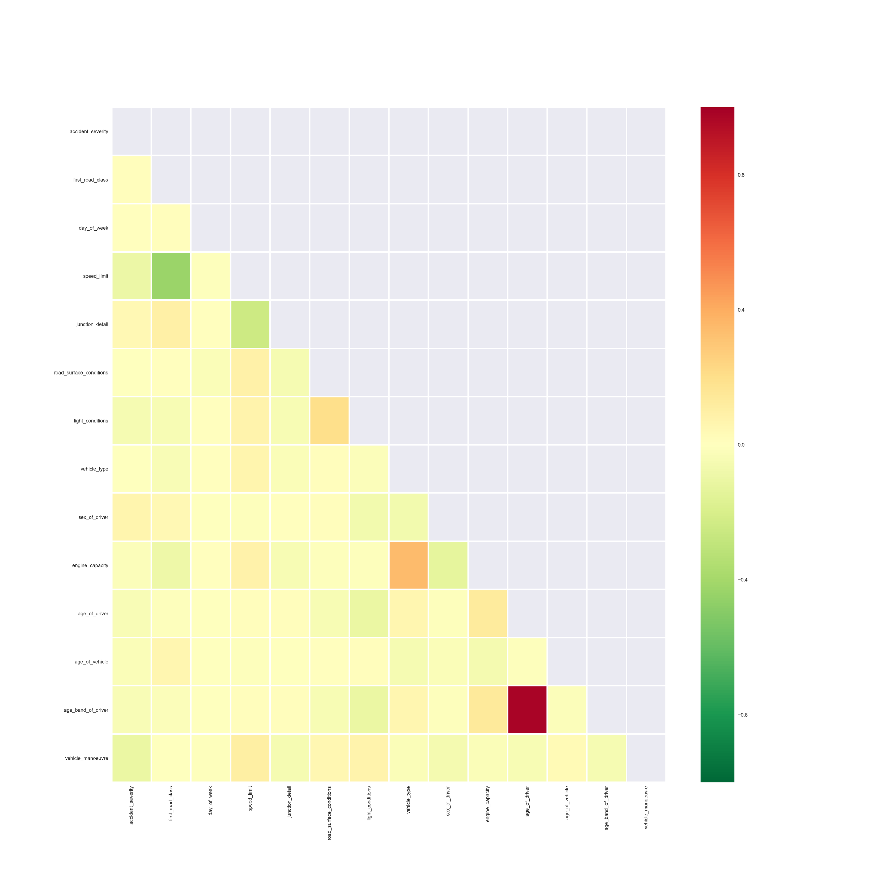
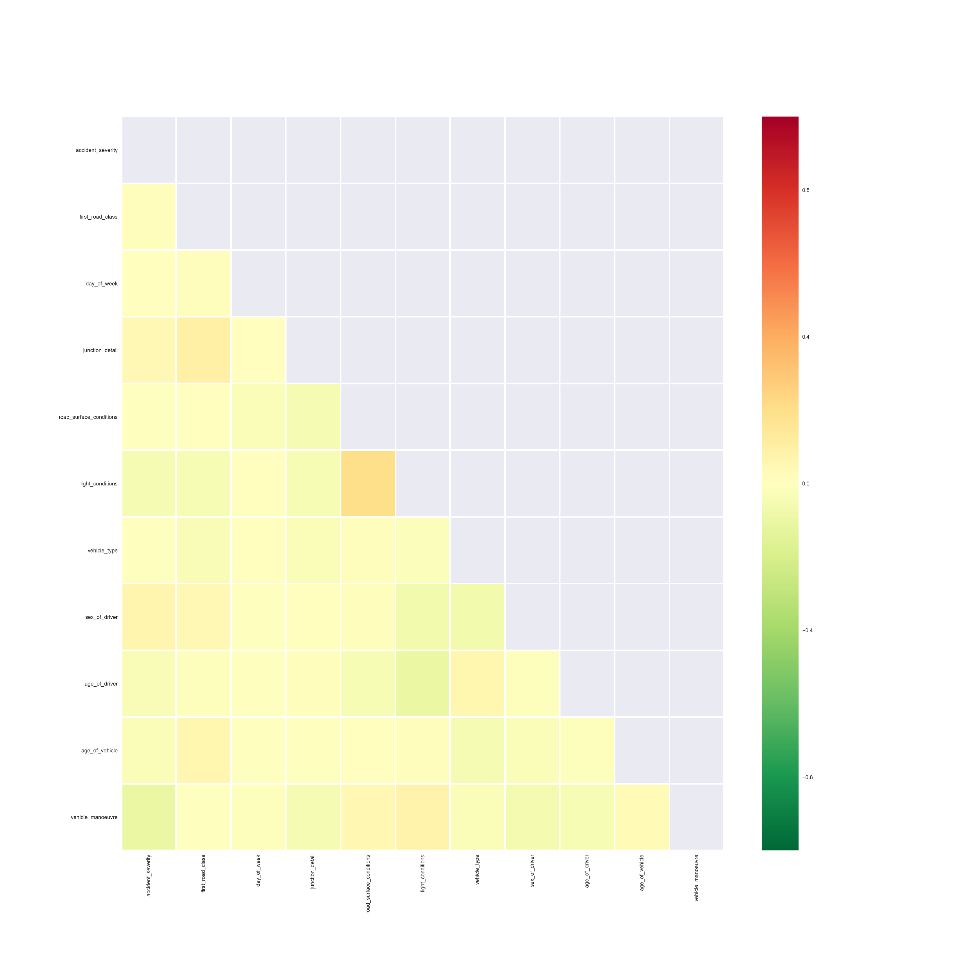
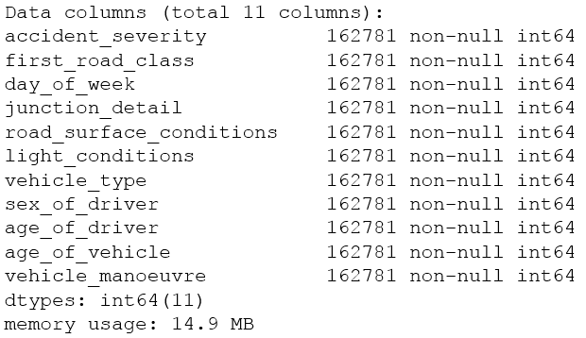
Correlation heatmaps Ordinal dataset
Initial feature choice
Removed correlations

Slide 31
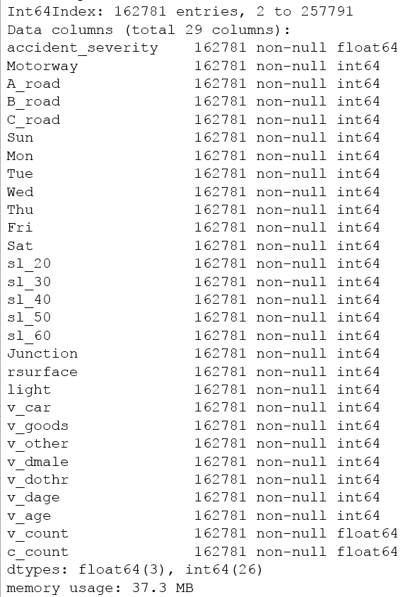
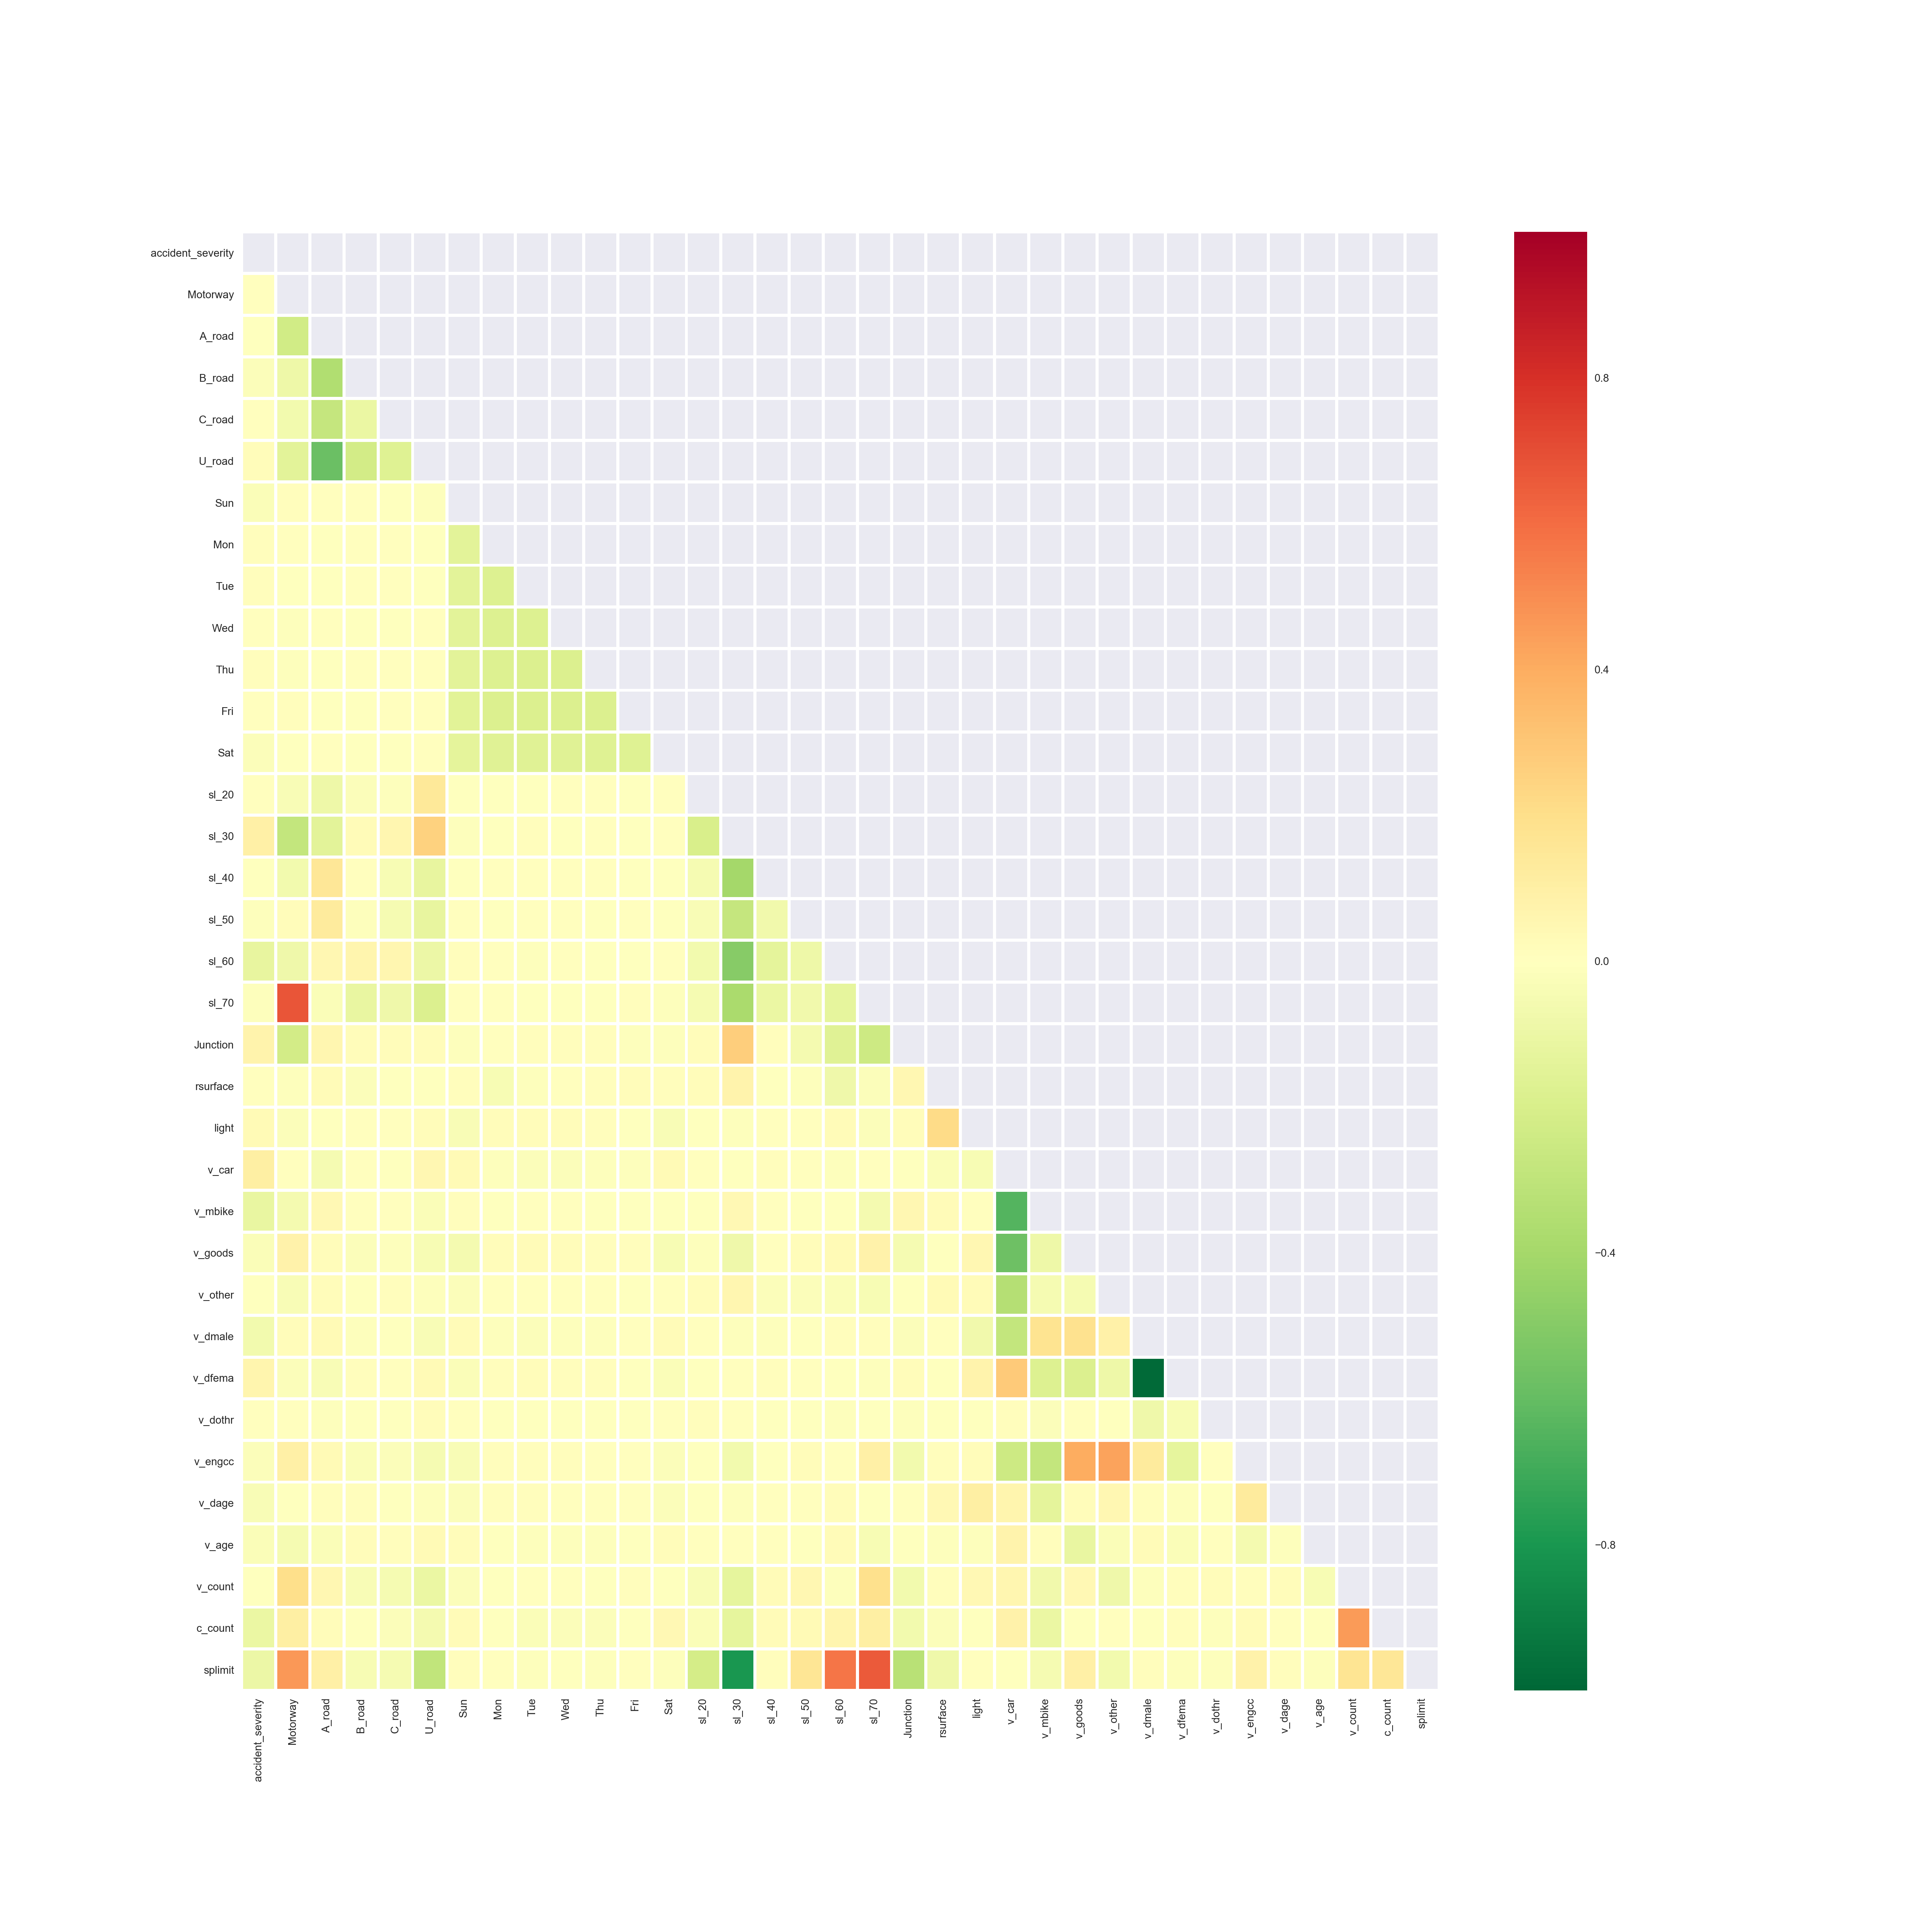
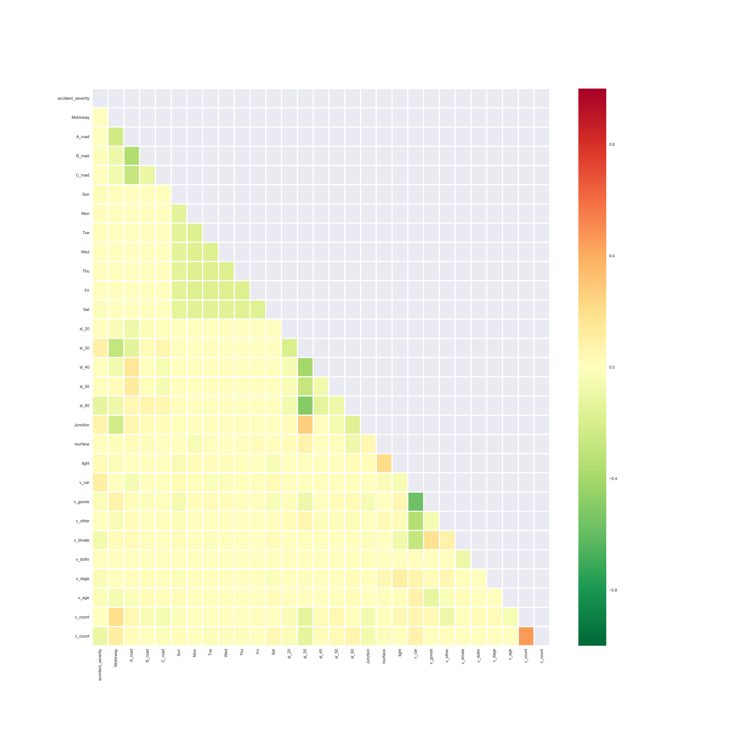
Correlation heatmaps Binary dataset
Initial feature choice
Removed correlations

Slide 32
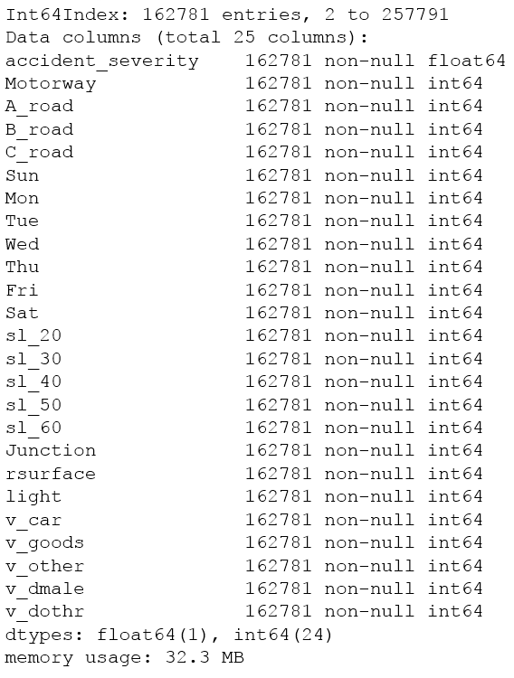
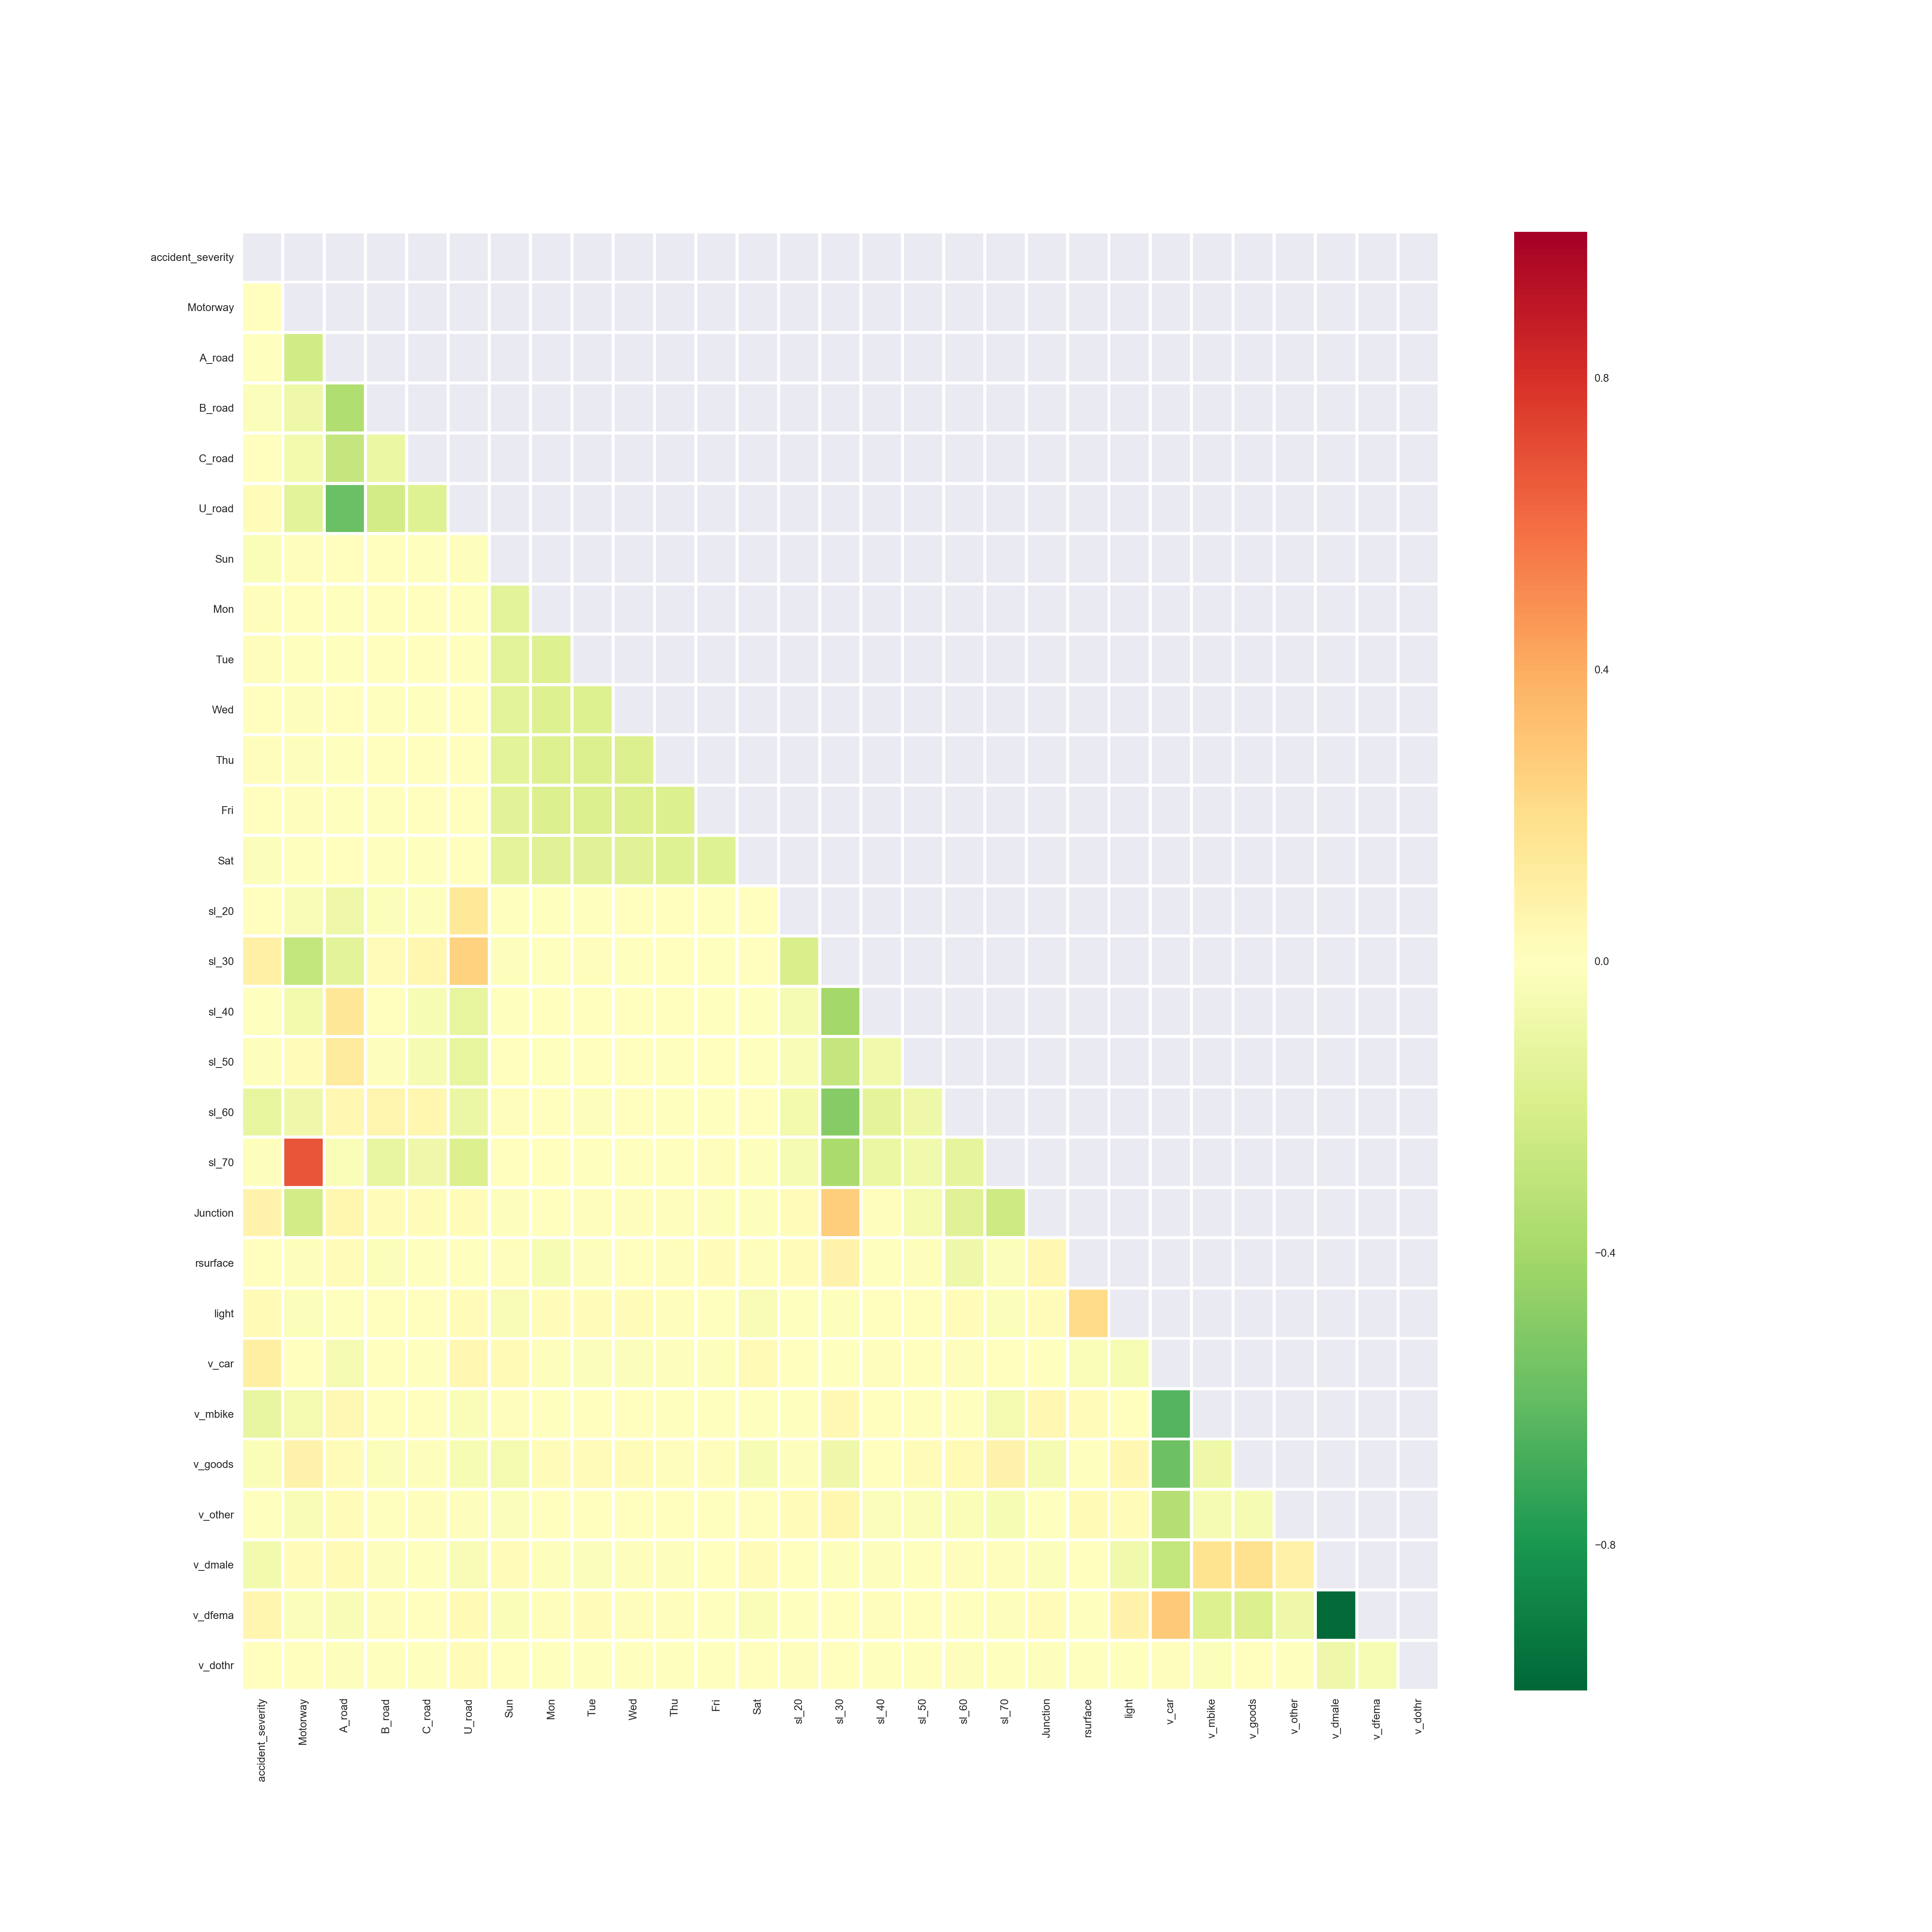

Correlation heatmaps Accident Severity dataset
Initial feature choice
Removed correlations

Slide 33
Classifier Best fit
Supervised Regression.
Limited ‘continuous’ data available for linear regression
Logistic Regression for continuous (e.g. vehicle age) to binary (e.g. car/not car) features
Supervised Identify classifiers
Niaeve Bayes: Gaussian and Multinomial
KNN
Provide accuracy scores and compare
Generate confusion matrixes
Cross-validation
➔ code for illustrations

Slide 34












Confusion Matrixes - summary

Slide 35

Accuracy results - summary

Slide 36
Conclusion

Slide 37
Project Conclusion
Roads (based on map plots)
Accidents cluster around highly densely populated areas
No discernible clustering of accident severity
Needs further assessment to conclude
Accident severity predictive Modelling (Machine Learning)
Classifiers chosen provide 75-85% predictive accuracy
Cross-validation does not significantly improve results across all classifiers
MultinominalNB provided consistently best accuracy results (85%) across all datasets
GaussianNB identified perfect accuracy in control sample

Slide 38
Project improvements
Tidy code and data
Citations in code
Provide IDE version
Performance optimization
Classifier tuning
Common code into import module
Scope
Further validation on conclusion (Determine recall and precision)
Trial data from other years
Complete ROADS development
Assess additional features (e.g. time)
Assess additional classifiers (e.g. Random Forests, SVC and Neural Networks)
Normalisation of data including use of population and driver statistics
Review additional data sources for accident impact (e.g. speed cameras)

Slide 39
Project effort breakdown
Choosing a project: 30% (3-4 weeks)
Data analysis: 40% (4-5 weeks)
Dataset preparation: 20% (2-3 weeks)
Machine learning: 10% (1-2 weeks)

Slide 40
Course Conclusion Data Science GA_DAT3
Challenging, but a great learning experience!
Many thanks to all!
Let’s stay in touch!

Slide 41
Appendix
Features

Slide 42
Other project ideas
Maybe if I had longer…
additional result preparation and perhaps different approaches in hindsight:
Leverage expansion of speed camera data: http://www.speedcams.eu/speedcameras (available for purchase)
incorporation of Wikipedia details: https://en.wikipedia.org/wiki/M25_motorway
Use of googlemaps: https://developers.google.com/maps/
Use of UK OS data: https://www.ordnancesurvey.co.uk/opendatadownload/products.html#OPROAD
Provision of dashboard road specific data analysis Postcode regional analysis
Assess other datasources for driver experience as a ‘feature’.
Someone has beaten me to it…
Inevitably with public data I have discovered other people's attempts to provide details on the accident data. I've avoided plagerism (honest!), but their ideas did trigger some thoughts:
http://www.mapsdata.co.uk/portfolio-items/traffic-accidents-uk/
http://www.crashmap.co.uk/Search
http://stackoverflow.com/questions/28341869/retrieve-all-latitude-longitude-points-within-x-distance-given-an-area
I wish I had thought of that…
Perhaps a less macabre application of public data, a little closer to home and along similar lines, is a project to find common names of Singapore roads in a great series of blogs (wish I had thought of this):
http://michelleful.github.io/code-blog//2015/04/24/sgmap/

Slide 43

Heat map
http://www.mapsdata.co.uk/portfolio-items/traffic-accidents-uk/

Slide 44

Accident Data

Slide 45

Vehicle Data

Slide 46

Casualty Data

Slide 47



Accident Data – Assessment (cont…)
0 - Not at junction or within 20 metres 1- Roundabout 2 - Mini-roundabout 3 - T or staggered junction 5 - Slip road 6 - Crossroads 7 - More than 4 arms (not roundabout) 8 - Private drive or entrance 9 - Other junction
1 - Dry 2 - Wet or damp 3 - Snow 4 - Frost or ice 5 - Flood over 3 cm. deep 6 - Oil or diesel 7 - Mud
1 - Fine no high winds 2 - Raining no high winds 3 - Snowing no high winds 4 - Fine + high winds 5 - Raining + high winds 6 - Snowing + high winds 7 - Fog or mist 8 - Other 9 - Unknown

Slide 48
Accidents – other fields (M-ways)
Data description | Range of codes/ Entity code | Example_Data | Comments | Field classifier
Police Force | See worksheet | 1 | Need to get JSON file for 'Police Force' areas (TBD) | Cluster
Local Authority (District) | See worksheet | 12 | Need to get JSON file for 'Police Force' areas (TBD) | Cluster
Local Authority (Highway) | ONS code - See worksheet | E09000020 | Need to get JSON file for 'Police Force' areas (TBD) | Cluster
Urban or Rural Area | 1 - Urban 2 - Rural 3 - Unallocated | 1 | Might help with heat map | Cluster
Lower Super Ouput Area of Accident_Location | (England & Wales only) | E01002825 | Need to get JSON file for 'Police Force' areas (TBD) | Cluster
Longitude | (Null if not known) | -0.198465 | pair with Longitude to make point location tuple | geoPoint
Latitude | (Null if not known) | 51.505538 | pair with Latitude to make point location tuple | geoPoint
Accident Index | YYYYmmLLnnnnn | 201501BS70001 | Key field to link with Vehicles and Casualties | Index
Accident Severity | 1-Fatal 2-Serious 3-Slight | 3 |  | Label
Number of Vehicles |  | 1 |  | Label
Number of Casualties |  | 1 |  | Label

Slide 49


Vehicle Data - assessment
1 - Reversing 2 - Parked 3 - Waiting to go - held up 4 - Slowing or stopping 5 - Moving off 6 - U-turn 7 - Turning left 8 - Waiting to turn left 9 - Turning right 10 - Waiting to turn right 11 - Changing lane to left 12 - Changing lane to right 13 - Overtaking moving vehicle - offside 14 - Overtaking static vehicle - offside 15 - Overtaking - nearside 16 - Going ahead left-hand bend 17 - Going ahead right-hand bend 18 - Going ahead other
1 - Male 2 - Female 3 - Not known -1 - NaN

Slide 50
Vehicle other fields (M-ways)
Data description | Range of codes/ Entity code | Example_Data | Comments | Field classifier
Accident Index |  | 201501BS70001 | Accindent Index Key | Index
Vehicle Reference |  | 1 | Vehicle Index Key | Index
Junction Location | 0 - Not at or within 20 metres of junction 1 - Approaching junction or waiting/parked at junction approach 2 - Cleared junction or waiting/parked at junction exit 3 - Leaving roundabout 4 - Entering roundabout 5 - Leaving main road 6 - Entering main road 7 - Entering from slip road 8 - Mid Junction - on roundabout or on main road -1 - NaN | 8 |  | geoPoint

Slide 51
Casualties – Field choice (M-Way)
Data description | Range of codes/ Entity code | Example_Data | Comments | Field classifier
Accident Index | Index to Accident | 201501BS70001 |  | Index
Vehicle Reference | SubIndex to Vehicle | 1 |  | Index
Casualty Reference | Index | 1 |  | Index
Casualty Class | 1 - Driver or rider 2 - Passenger 3 - Pedestrian | 3 |  | Label
Sex of Casualty | 1 - Male 2 - Female 3 - Not known -1 - NaN | 2 |  | Feature
Age of Casualty |  | 41 |  | Feature
Age Band of Casualty | 1 - 0 - 5 2 - 6 - 10 3 - 11 - 15 4 - 16 - 20 5 - 21 - 25 6 - 26 - 35 7 - 36 - 45 8 - 46 - 55 9 - 56 - 65 10 - 66 - 75 11 - Over 75 -1 - NaN | 7 |  | Feature
Casualty Severity | 1 - Fatal 2 - Serious 3 - Slight | 3 |  | Label

